Slide 1
Project management
-If you fail to plan, then you plan to fail.

Slide 2



Project management includes determining the scope, the scheduling and the budget.
The scope involves seeing the whole project and what needs to be done.
Scheduling is about planning when things should be completed to finish on time.
Budgeting allows for appropriate distribution of funds.

Slide 3
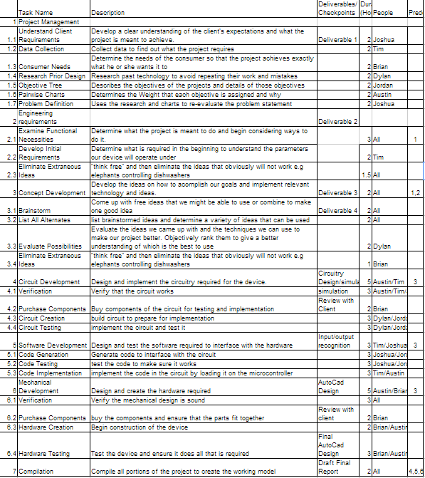
The Work Breakdown Structure is an organization of the tasks that need to be accomplished.
This one includes a description of the major parts of the project.

Slide 4
Gantt chart-

Slide 5

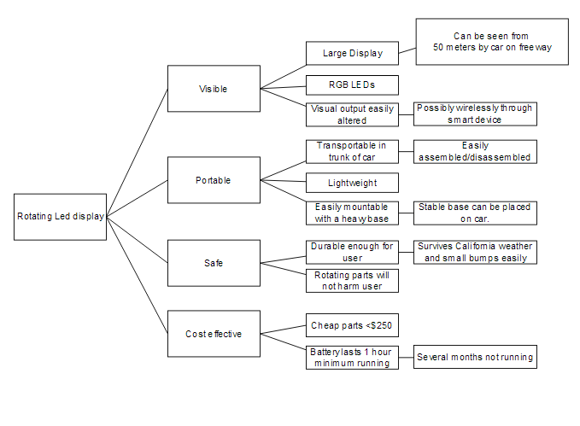
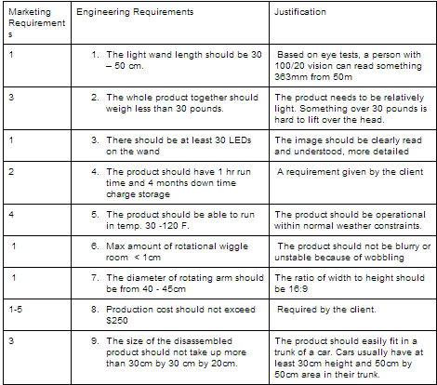


Our plan (part 1)
Task Name | Start | Finish | Duration | Predecessors
1. Understand Client Requirements | Wed 1/15/14 | Mon 2/3/14 | 14 days
2. Examine Functional Necessities | Wed 1/15/14 | Thu 1/23/14 | 7 days
3. Concept Development | Tue 2/4/14 | Fri 2/14/14 | 9 days | 1,2
4. Preliminary Design | Sat 2/15/14 | Thu 2/27/14 | 10 days | 3
5. Detailed Design | Fri 2/28/14 | Thu 3/6/14 | 5 days | 4

Slide 6
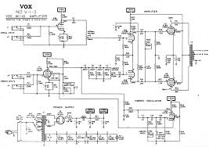



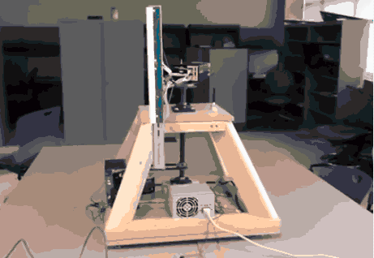
Our plan (part 2)
Task Name | Start | Finish | Duration | Predecessors
6. Circuit Development | Fri 3/7/14 | Fri 3/28/14 | 16 days | 5,3,4
7. Software Development | Fri 3/7/14 | Fri 3/21/14 | 11 days | 3,4,5
8. Mechanical Development | Fri 3/7/14 | Fri 3/28/14 | 16 days | 3,4,5
9. Document Design Process | Fri 3/7/14 | Fri 3/14/14 | 6 days | 3,4,5
10. Compilation | Sat 3/29/14 | Mon 4/14/14 | 12 days | 7,8,9

